Slide 1
AWS & Azure Cloud Services
Analyzing features and benefits of top cloud platforms
Razin Bin Zaidun

Slide 2
Agenda
Introduction of AWS & Azure Cloud Services
Integration of Services
Service management system
Cost Optimization
Summary & Recommendation

Slide 3
Introduction

Slide 4
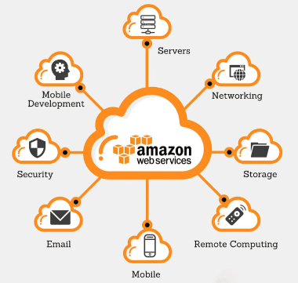
What is AWS Cloud Services?
World’s largest cloud platform launched in 2006.
AWS offers a broad service of 200+ catalog and global availability
Known for its flexibility, global level infrastructure and developer-friendly tools.
Popular cloud service for startups, tech innovators and global enterprises.

Slide 5
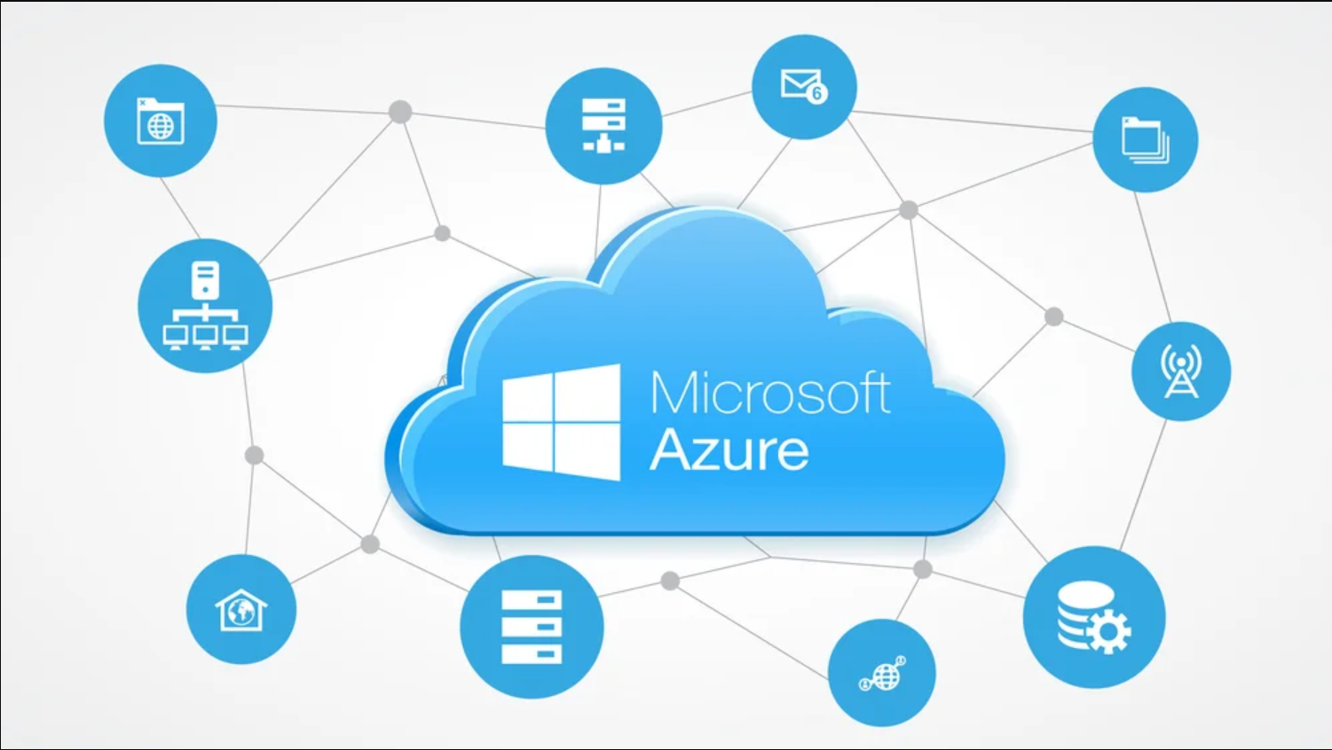
What is Azure Cloud Services?
Azure is the second-largest cloud platform, widely adopted by 95% of Fortune 500 companies.
It stands out for its tight integration with Microsoft products like Windows Server, SQL Server, Office 365, and Active Directory.
Azure is ideal for enterprises, regulated industries and hybrid cloud environments.

Slide 6
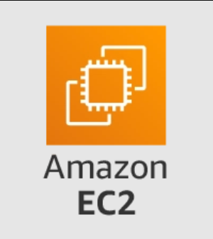
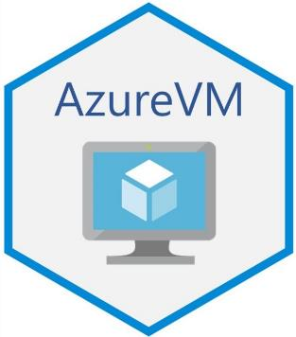
Integration of Services
AWS
AWS offers powerful, platform-agnostic integration but may require extra customization for Microsoft-heavy systems.
Azure
Azure seamlessly integrates with Microsoft products like Active Directory and Office 365 for unified identity and workflows.

Slide 7

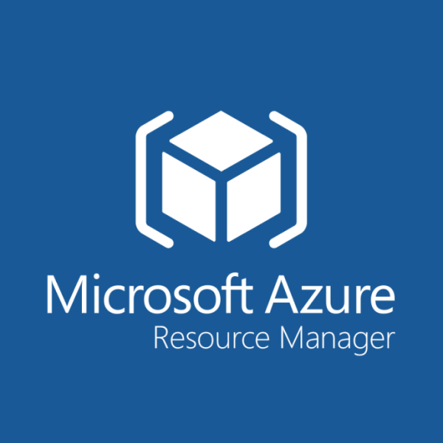
Service Management System
Both Cloud Services offer a centralized management system.
Azure:
Azure Resource Manager (ARM) for unified deployment
Emphasizes on visual workflows
AWS:
CloudFormation & AWS Systems Manager
AWS offers granular control

Slide 8

Cost Optimization
AWS:
Spot Instances provide up to 90% discounts on unused EC2 capacity, best for fault-tolerant and batch jobs.
Azure:
Hybrid Benefit allows reuse of existing Microsoft licenses. Saving up to 85% on VM and database costs.
Both services have auto scaling on demand.

Slide 9

Targeted Users
AWS’s large catalogue of 200+ services are best suited for startups and developers and the general use case for most enterprises.
Azure’s seamless integration with existing Microsoft features and licenses are best suited for enterprises reliant on the Microsoft ecosystem.

Slide 10
Summary and Recommendations

Slide 11
AWS or Azure Cloud Services
In summary, both cloud services offer a wide range of products from computing instances to database instances for enterprises. Both offer simple and informative centralized management system for its products.
Enterprises who utilize the Microsoft Ecosystem the most would benefit heavily from Azure Cloud Services as it integrates seamlessly with the ability to reuse existing Microsoft Licenses for a more cost-effective implementation.
Enterprises who are generally looking for a cloud-based solution as their solution would benefit greatly from AWS large catalogue of 200+ services to be utilized.

